Slide 1

WELCOME TO
Schemes and Policies of Ministry of MSME,GOI
Sandeep Agarwal
Assistant Director
Ministry of MSME,GOI

Slide 2
Do you know what MSME is…
Let’s have a quick introduction with us

Slide 3
INVESTMENT CEILING FOR PLANT &
MACHINERY OR EQUIPMENTS
(Valid upto 30 June,2020)
CLASSIFICATION | MANUFACTURING ENTERPRISES | SERVICE ENTERPRISES
MICRO | Up to Rs. 25 Lakh | Up to Rs. 10 Lakh
SMALL | Above Rs. 25 Lakh & up to Rs. 5 Crore | Above Rs. 10 Lakh & up to Rs. 2 Crore
MEDIUM | Above Rs. 5 Crore & up to Rs. 10 Crore | Above Rs. 2 Crore & up to Rs. 5 Crore

Slide 4
TURNOVER AND INVESTMENT CEILING ( In Rs.) FOR PLANT & MACHINERY (New Definition)
https://udyogaadhaar.gov.in/
CLASSIFICATION | MANUFACTURING /SERVICE ENTERPRISES
MICRO | Investment upto 1 crore and turnover upto 5 crore
SMALL | Investment upto 10 crore and turnover upto 50 crore
MEDIUM | Investment upto 50 crore and turnover upto 250 crore

Slide 5
MSMEs at a glance :
A. a) SSI Registration 15,63,974 upto 2006
b) Entrepreneur Memorandum 21,96,902
between 2007-2015.
c) UAM 1,01,13,814 from Sept. 2015
d) Total registration till 24 June, 2020
1,38,74,690
B. Estimated MSME : 633.88 lakh
Rural : 324.88 Lakh
Urban : 309.00 Lakh
Source: Annual Report, 2018-19,Ministry of MSME

Slide 6
C. Manufacturing : 196.65 lakh
Trade : 230.35 lakh
Services : 206.85 lakh
D. Micro : 630.52 lakh
Small : 3.31 lakh
Medium : 0.05 lakh
Total : 633.88 lakh
E. Employment in MSME
Manufacturing : 360.41 lakh
Trade : 387.18 lakh
Services : 362.22 lakh
Source: Annual Report, 2018-19,Ministry of MSME

Slide 7
ELIGIBILITY TO AVAIL GOVT. SCHEMES
Any MSE unit who has filed an Udyog Aadhaar Memorandum (UAM) (udyogaadhaar.gov) in with the appropriate authority or who has erstwhile DIC registration will be eligible for support under the Schemes implemented by Ministry of MSME,GOI.

Slide 8
“Credit Link Capital Subsidy Scheme for Technology
Up-Gradation”

Slide 9
The revised scheme aims at facilitating technology up-gradation by providing 15% upfront capital subsidy upto (upper limit of) Rs 15 lakhs to MSE, including tiny, khadi, village and coir industrial units on institutional finance availed of by them for induction of well established and improved technologies in the specified sub-sectors/ products approved under the scheme.

Slide 10
Credit Guarantee Fund Scheme for
MICRO & SMALL Enterprises

Slide 11
The credit facilities which are eligible to be covered under the scheme are both term loans and working capital facility upto Rs. 200 lakhs per borrowing unit, extended without any collateral security or third party guarantee, to a new or existing micro and small enterprise.
The guarantee cover available under the scheme is to the extent of 75% of the sanctioned amount of the credit facility.

Slide 12
The Guarantee cover under the scheme is for the agreed tenure of the term loan/composite credit. In case of working capital, the guarantee cover is of 5 years or block of 5 years.
The fee payable to the Trust under the scheme is one-time guarantee fee of 1.5% & annual service fee of 0.75% on the credit facilities sanctioned. For loans upto Rs. 5 lakh, the one-time guarantee fee and annual service fee is 1% and 0.5% respectively.

Slide 13
For further details, Please visit
www.cgtmse.in

Slide 14
“Lean Manufacturing”

Slide 15
To improve productivity and minimize wastage in Manufacturing Enterprise
Mini Cluster
Special Purpose Vehicle (SPV)
Group of 6 to 10
Nodal Agency: PPDC AGRA
80% GOI
20% Association’s contribution

Slide 16
Lean Manufacturing(LM) is better production of goods by:
Eliminating non-value added activities / wastes
Helping to produce more with same resources
Scheme is under operation for 500 mini clusters.
PPDC Agra is working as Monitoring & Implementing Agency.

Slide 17
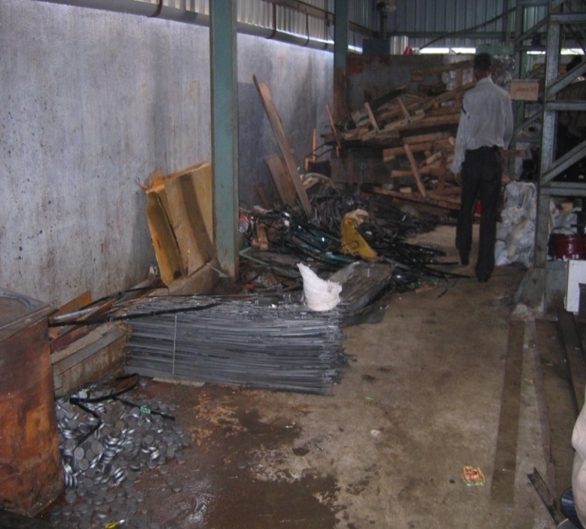
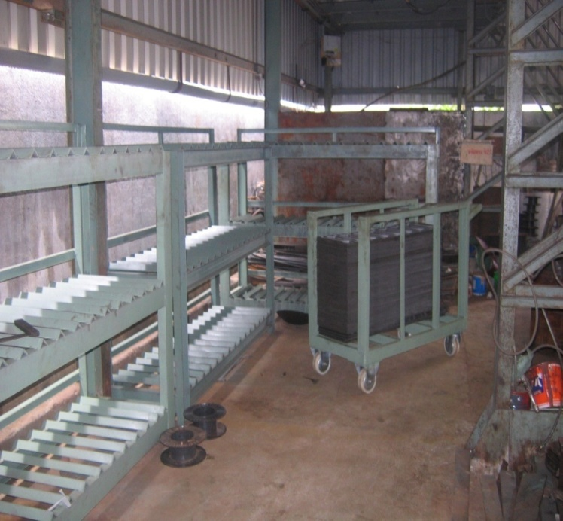
BEFORE AFTER

Slide 18
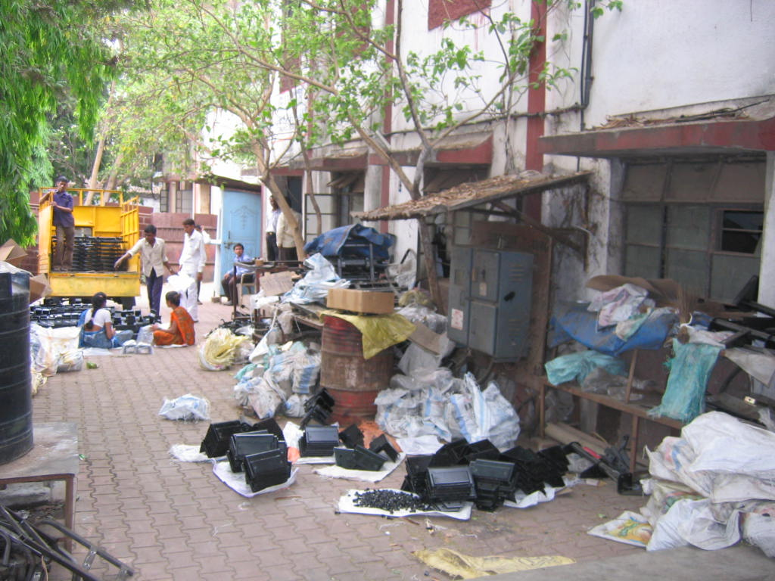
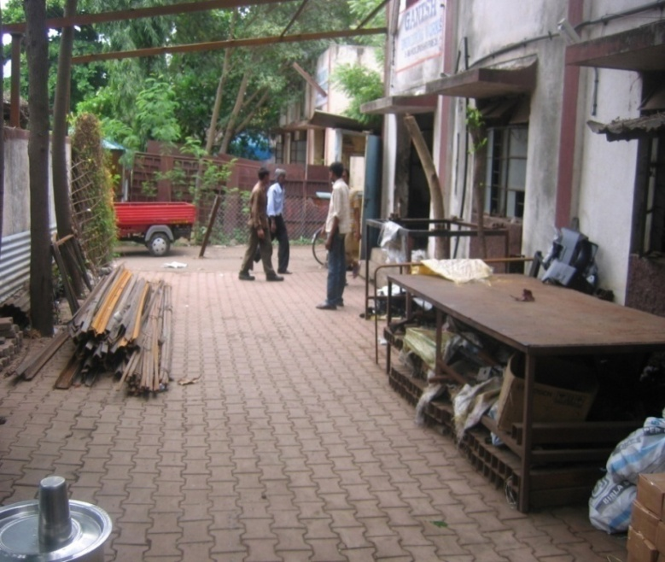
BEFORE AFTER

Slide 19
“Support for Entrepreneurial & Managerial Development of SMEs Through Incubators”

Slide 20
To promote emerging technological and knowledge-based innovative ventures that seek the nurturing of ideas from professionals.
Entrepreneurial ideas have to be fostered and developed in a supportive environment before they become attractive for venture capital.
To promote networking and forging of linkages with other constituents of the innovation chain for commercialization of their developments.
Rs15 lakhs per idea/unit. Implemented through Technical/ Management Institutes.

Slide 21
Implementation of Design Expertise to Manufacturing MSME Sector

Slide 22
Undertaking Design Projects by Professionals-
For Micro Unit GOI : 75%
For SME Unit GOI : 60%
PROJECT RANGE : 15-40 lakhs
Payment in Three Stages
Strategy & Concept : 40 %
Detail Design : 30%
Implementation Report : 30%
Nodal Agency :NID, Ahmedabad,
:IISc Banlore
:IIT,NIT & Toolroom

Slide 23
Student design project funding
Reimbursing 75 % expenses subject to Rs.1.5 lakhs total project cost
MSME Units contribution 25 % (Student designer stipend, conveyance, documentation & model making costs
Funding in 3 stages
Stage 1-Application approval : 25%
Stage 2-Mid Stage : 25%
Stage 3 Final Report : 50%
Project duration : One Year

Slide 24
“Building Awareness on Intellectual Property Rights” (IPR) for MSMEs

Slide 25
Assistance for Grant on Patent/ GI Registration:
Domestic Patent :1 lakh
Foreign Patent : 5 lakh
GI Registration : 2 lakh
Trademark : 0.10 lakh
Assistance for setting up IP
Facilitation Centre :100 Lakh

Slide 26
“Procurement & Marketing Support”

Slide 27
Participation of MSE in Domestic Fair/Exhibition
Space Rent Charge:
- 80% Gen
- 100%SC/ST/W/NER/PH
upto Rs 30000/-
Contingencies Expenses:
(Travel, Publicity etc)
100% upto Rs 15000/-

Slide 28
Micro & Small Enterprises-
Cluster Development Programme
(MSE-CDP)

Slide 29
GUIDING PRINCIPLES FOR CFC
In term with the long term vision
Avoidance of duplication of facilities
Project cost : Rs. 20 crores/ Cluster
GOI grant : 70% of the Project cost
(90% for projects in N.E. & hill states, more than 50% micro, women & SC/ST units)

Slide 30
The remaining portion to be provided by the state government concerned & project beneficiaries.
In all the cases, the entire cost of land and building shall be met by SPV/ state government concerned.

Slide 31
The CFC may be utilized by :
SPV members
Other cluster members

Slide 32
Special purpose vehicle (SPV), i.e., Society/Trust/ Co. :To be formed by Cluster Beneficiaries before seeking Funds for Common Facility Centre (CFC)
Min. no. of Enterprises : 20 Nos.
In special cases : 10 Nos.

Slide 33
Public Procurement Policy-2012
for MSE’s

Slide 34
MSE’s registered with District Industries Centre or Khadi and Village Industries Commission (KVIC) or Khadi and Village Industries Board (KVIB) or Coir Board or NSIC or Directorate of Handicrafts & Handloom or any other body specified by Ministry of MSME.
It has come into force from 1st April, 2012.
After a period of three years i.e. from 1st April, 2015, overall procurement goal of 20 (Now 25) percent shall be made mandatory.

Slide 35
Every central ministry or department or PSU shall set an annual goal of procurement from MSE’s from the financial year 2012-13 and onwards, with the objective of achieving an overall procurement of minimum of 20 (Now 25) percent, of total annual purchases of products purchased and services rendered by MSE’s in a period of 3 years.

Slide 36
SIDBI safe loan for msmes
Upto 100% finance for Capex/working capital
All MSMEs relating to fight Corona virus
Maximum upto 50 lakhs
Interest 5% per annum
Term loan repayment in 5 years including moratorium
Working capital repayment in 18 months
Collateral free
Upto September 30, 2020
https://onlineloanappl.sidbi.in

Slide 37
3 lakh crore collateral free automatic loan to msmes
Emergency credit line from bank and NBFC upto 20% entire outstanding credit as on 29.02.2020
Borrower with upto 25 crores and 100 crores turnover
Loan repayment 4 year tenure/moratorium of 12 months on payment of principle
ROI – 9.25% bank, 14% NBFC
Scheme upto 31st October or sanction of 3 lakh crores (whichever is earlier)
45 lakh units to be covered including MUDRA borrowers
Eligibility: Regular /SMA-0/SMA-1
For more details www.champions.gov.in

Slide 38
government to support stressed msmes with infusion of Rs 20,000 crore equity support through subordinate debt
MSME either NPA or under stress
Partially guaranteed
Unit should be functioning
More than 2 lakh MSMEs likely to be benefitted
Government to infuse Rs 4000 crore in credit guarantee trust for MSMEs
Support to distressed Unit a debt facility of 15% Promoters contribution or Rs 75 Lakh
For more details www.champions.gov.in

Slide 39
50,000 crore equity infusion for msme/launch of fund of funds
MSMEs with good viability
MSMEs likely with public issues
Corpus of Rs 10,000 crore created
Private Equity/Bencher capital
To help potential MSMEs in expansion
For more details www.champions.gov.in

Slide 40
Global tenders upto Rs 200 crore to be disallowed for government tenders to enable MSMEs to participate in government procurement process
GOI and CPSU to clear all receivables of MSMEs in the next 45 days
All central agencies like railways, road transport, CPWD etc. to grant extension of contracts upto 6 months without cost to contractor

Slide 41
For more details, please visit
www.champions.gov.in for reporting problems
my.msme.gov.in for online application
www.dcmsme.gov.in for schemes
M-9891208815

Slide 42


